Slide 1

Multiplayer web games
A Guide on how to use socket io in conjunction with three js to create a multiplayer game.

Slide 2
Goals
Give an introduction on how to use socket io by working through a demo project
Give insight into how I would go about creating a multiplayer game in three js and structuring the code
Code is shared in this presentation, however the way it is presented means you wont be able to simply copy and paste a working solution

Slide 3
Design
We will follow a client server model when designing our networking
This means if client a wants to communicate with client be they must send a message to the server who will relay that message to the appropriate client
We will use a client authoritative model, trust the client.

Slide 4
Library
We will be using socket io to do our networking. Socket io is a library which makes working with websockets super easy and convenient.

Slide 5
What is a socket
A socket is a communication protocol allowing for a persistent two-way connection between devices facilitating real time data transfer.

Slide 6
80 / 20 rule
The 80 / 20 rule states that 80% of outcomes come from 20% of causes.
In the case of socket io there is just a few functions (20%) that are used very commonly across the project (80%). So if you can know these few functions you will have enough knowledge to create a multiplayer game.
So what are these functions?

Slide 7
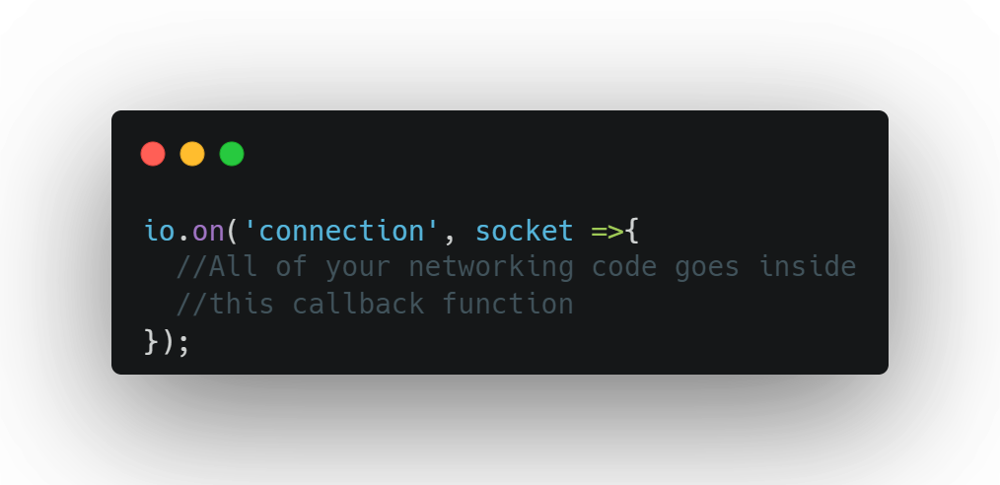
Assume io here is an object accessible from this scope
Notes:
What this does is assigns an event listener to react to a socket connecting to the server.
This callback will be ran on the server for each socket when they connect to the server. Each socket represents a two way communication between server and client

Slide 8
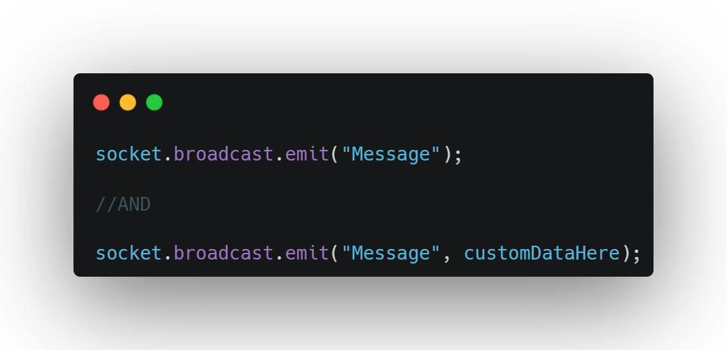
Assume socket here is an object accessible from this scope
Special use of emit. emit is covered in a sec

Slide 9
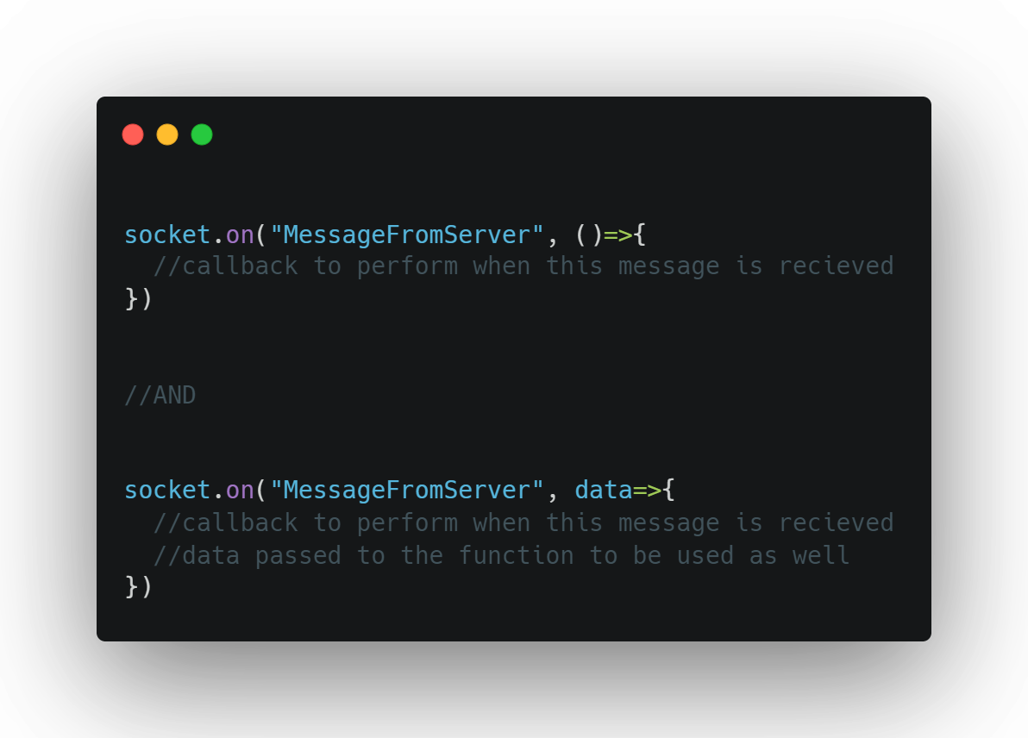
Assume socket here is an object accessible from this scope
This is how to react to messages from the server

Slide 10
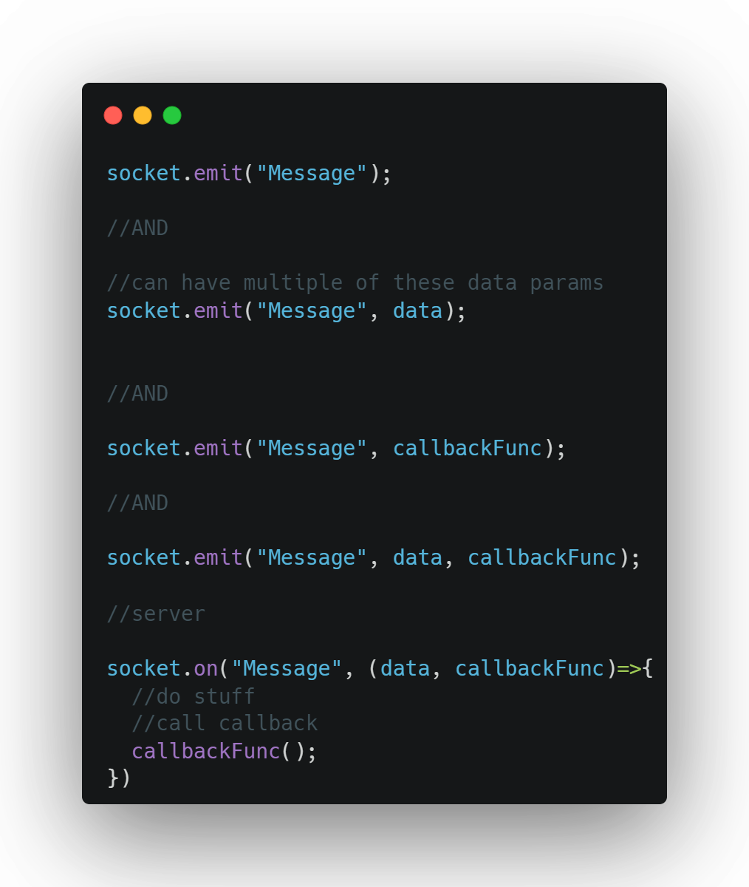
Flexibility in what we send when we send messages

Slide 11
That’s it!

Slide 12
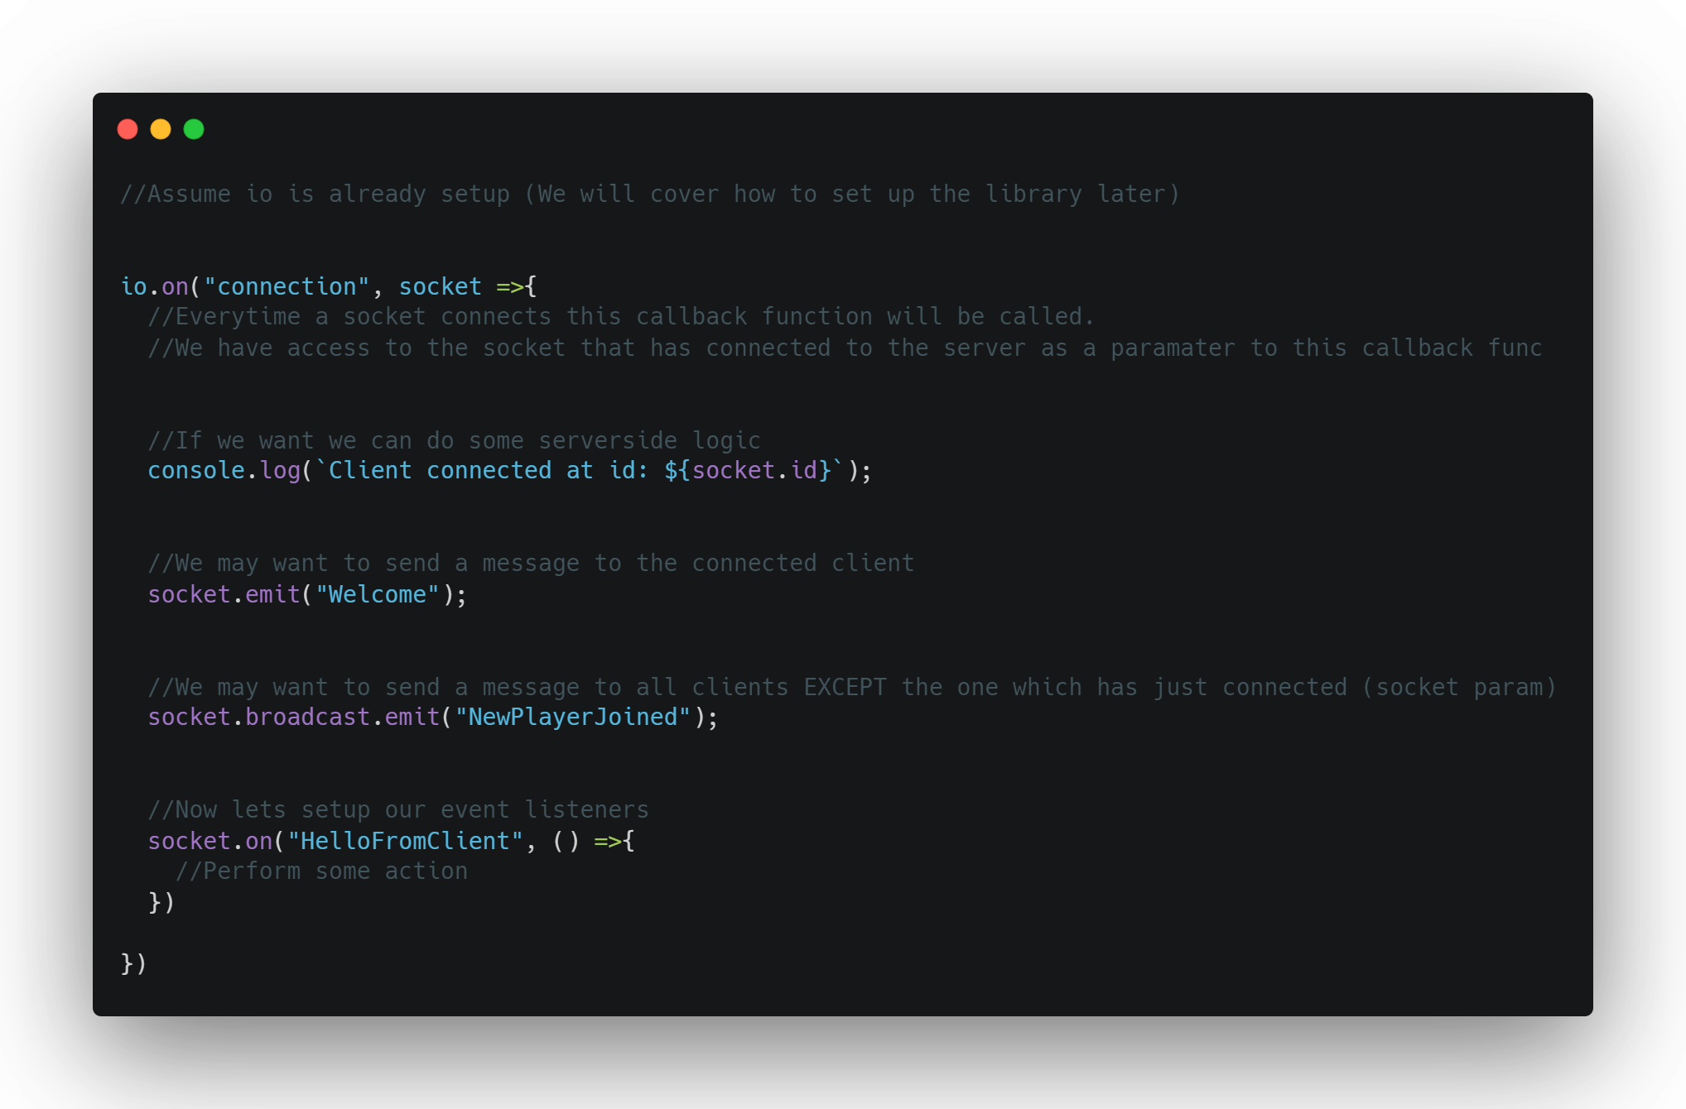
All Together

Slide 13
Quick recommendation before we start
I used Jetbrains Rider as my ide for this
And it was leagues above any other ide’s that ive used so far.
It actually has IntelliSense you can be confident in and also has IntelliSense for all the THREEjs symbols which was very useful.
Its recently became free via a community licence but is also available to students
So yeah… get rider its great!

Slide 14
Demo Scene

Slide 15
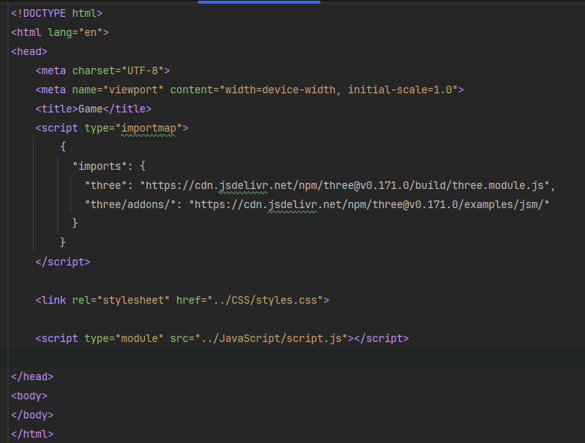
How it's made part 1 setting up the scene
In this step we will just get the three js hello world up and running and served from express.
So well make an index html file with a link to a css file, javascript file and an import map to import all our three js dependencies
Very simple stuff we've seen before

Slide 16
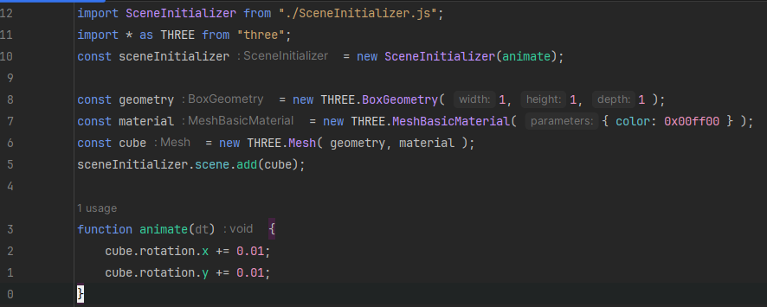
How it's made part 1 setting up the scene
Next we’ll get some javascript in to get a cube spinning
You may notice that my main file is very small (12 lines). This is intentional, all the complexities of setting up a scene is all handled by the sceneInitializer.
All of your networking code is going to be in this file so keeping your code clean by separating it out into different files and classes will really be worth the time it takes.

Slide 17
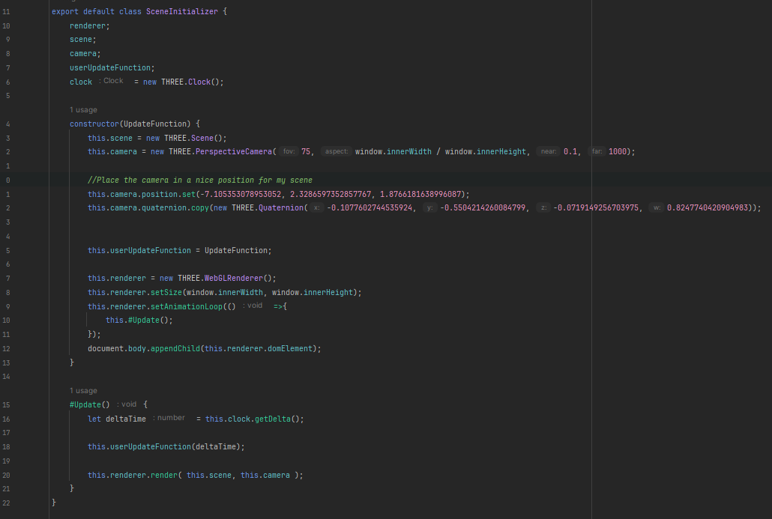
How it's made part 1 setting up the scene
Just for reference here is the SceneInitializer.
It has a few member variables but essentially just sets three js up for us so its ready to be used leaving our main file clean

Slide 18
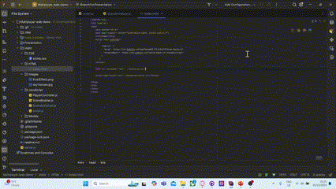
Run with live server
So when we run this using a live server from our ide we can see our three js scene rendering

Slide 19
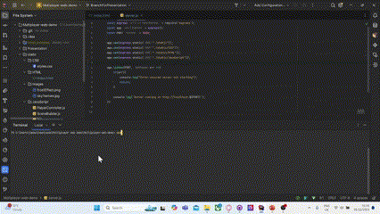
Next serve these files with express (server)

Slide 20
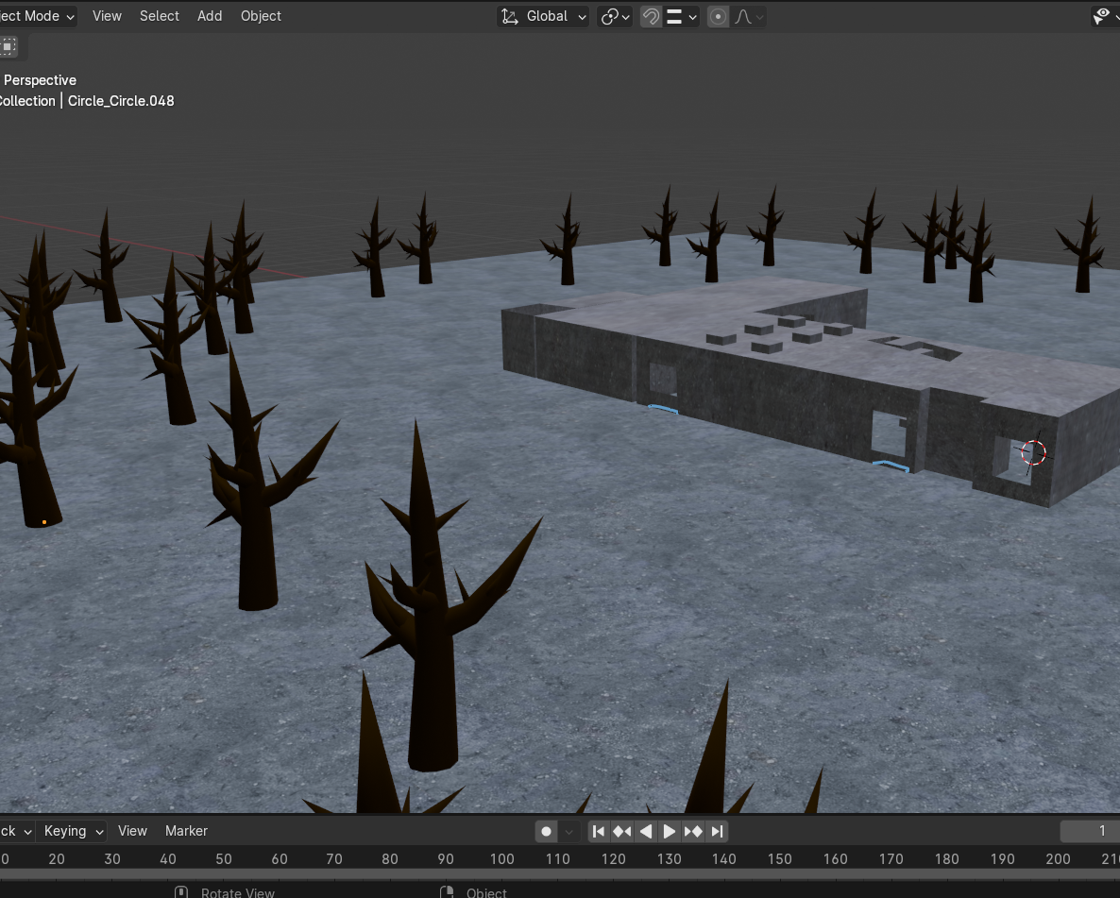
Now lets make our scene look pretty…
Well make a scene in blender and export everything into a gltf
This is contained in the static folder with
Your other client resources like
Sky sphere textures and source code

Slide 21
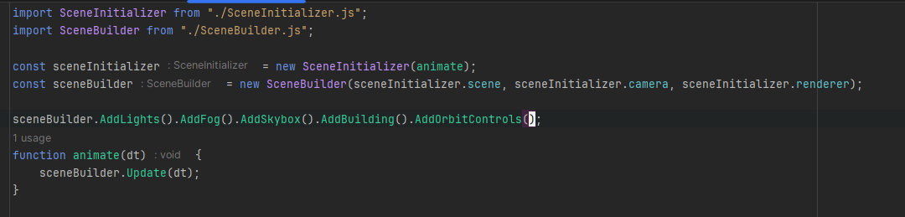
Getting it into three.js
So in our main js were going to import our SceneBuilder class (which ill show in a sec), create a new instance of a sceneBuilder and chain together a bunch of methods to build our scene in one line.
Well also call scene builders update function in our animate function. This way any objects like our orbit controller for example can be updated

Slide 22
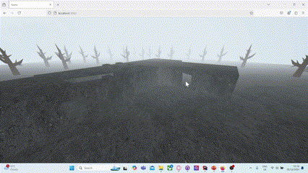

Slide 23
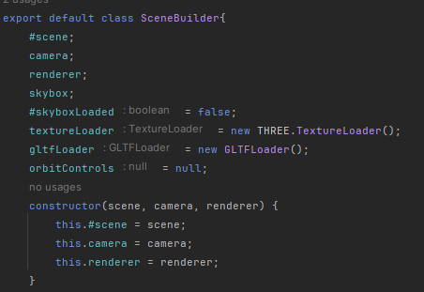
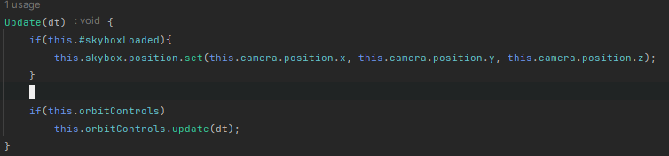
Scene Builder
The scene builder is composed of some useful member variables, a simple constructor, an update function and…

Slide 24
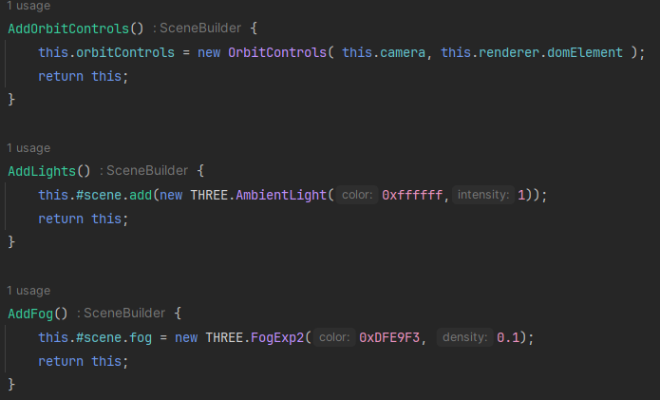
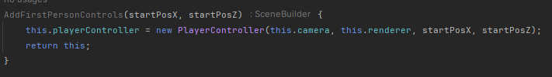
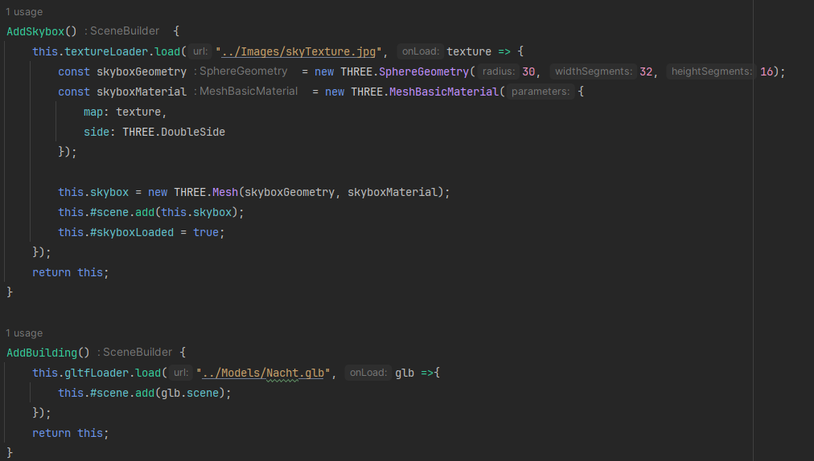
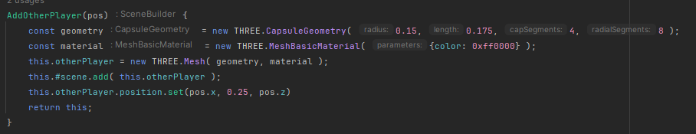
And…
a bunch of chainable methods which allow us to build our scene by adding a bunch of smaller parts to our scene

Slide 25
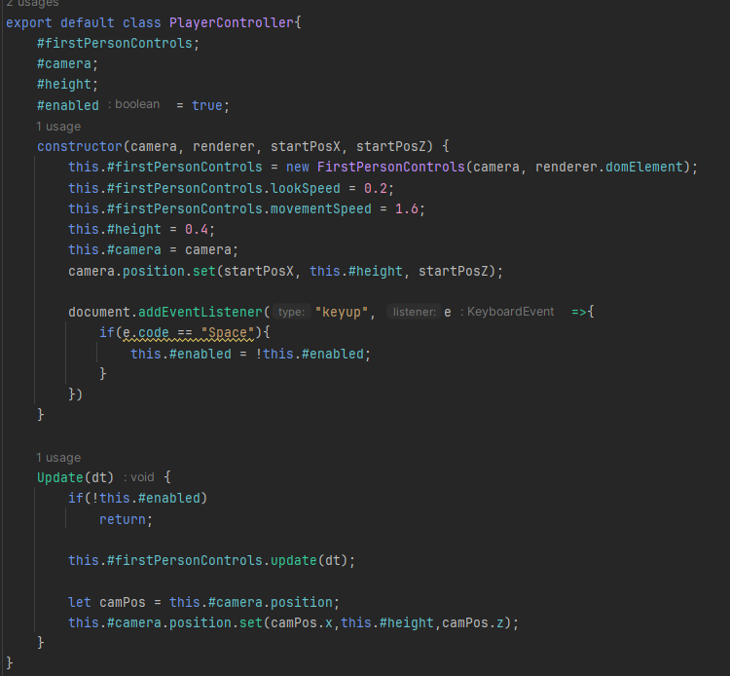
Okay the last thing we've got to do is get a player controller in
This player controller is just a wrapper around the FirstPersonControls class provided by three js.
The only additions made by this class to the FirstPersonControlls class from THREE.js are
the y axis is fixed
You can enable / disable the FirstPersonControls by pressing space

Slide 26
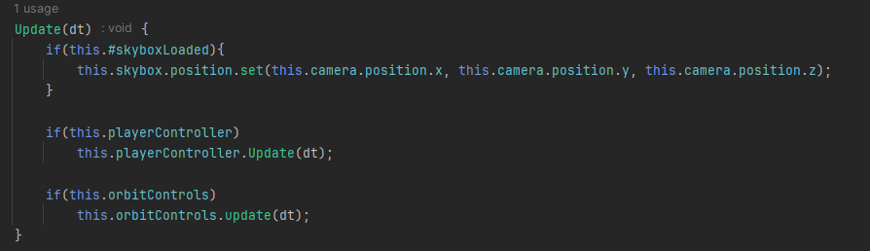
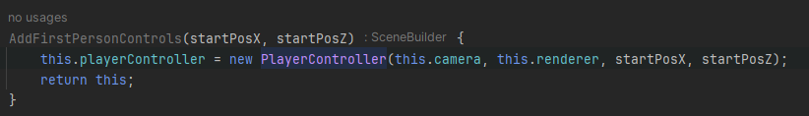


We can make a small change to our scene builder to give it the ability to add a player controller into our scene

Slide 27



Now we can swap out our orbit controls for our first person controls

Slide 28
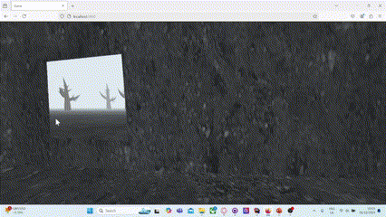
Yipeeee
Also if anyone could tell me what environment I have recreated here that would make me very happy 😉
We have now constructed a base project which we can make multiplayer.

Slide 29
The aim will be to have two clients able to connect to the server and see each other walk around. A client can leave and join back at any time.
A limitation of the system we will build is that it will be made for only 2 clients to connect at once you will have to think or experiment yourselves if you want more than 2 clients 😉
Doesn’t handle disconnections then reconnections well same again 😉

Slide 30
Time to make it multiplayer!!

Slide 31
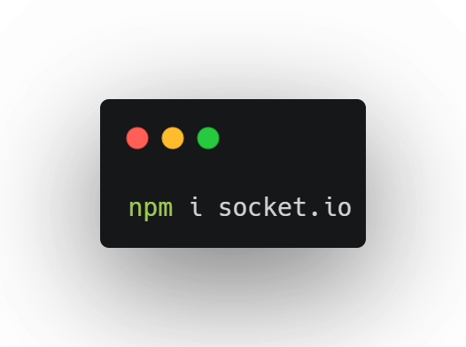
Server
First we will use npm to install socket io

Slide 32
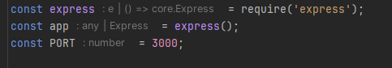
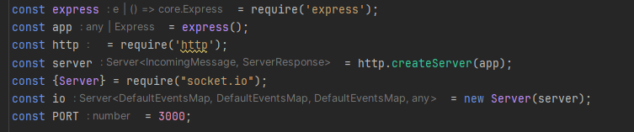
Now lets edit our server code
We will add a layer over the top of our express server to make the server an express and socket io server

Slide 33
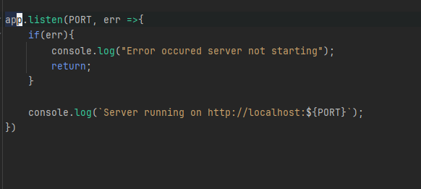
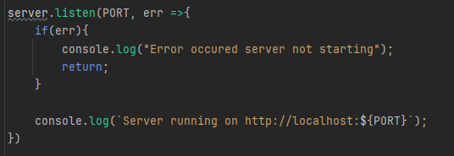
Now lets edit our server code
Instead of app.listen to start our server we can use server.listen

Slide 34
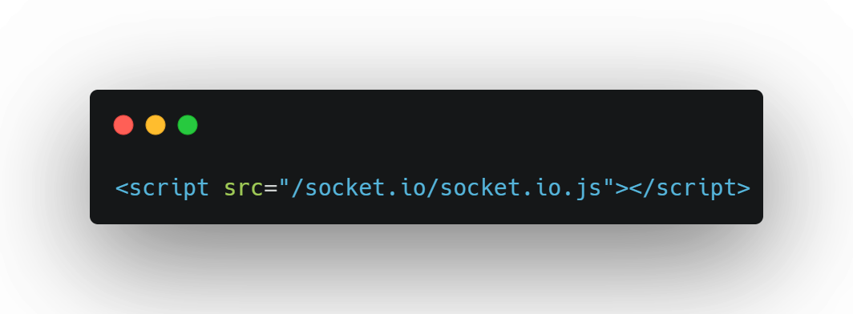
Next add socket io to the client
If your wondering how this socket.io.js file actually gets to your client. Heres how
The node package socket.io we installed earlier (npm) includes both the server side and client side code.
When we set up our server with socket io the endpoint /socket.io/socket.io.js was automatically created.
Anyone who has made a server so far has set up their own endpoints. Looks something like
app.get(“Address”, (req, res) =>{}); see if you can see it in your code

Slide 35

continued
Then when html sees our <script> tag it makes a http get request to the src which in this case is “socket.io/socket.io.js” and the server returns the client side library code

Slide 36
Okay now we are ready to start using the library!

Slide 37
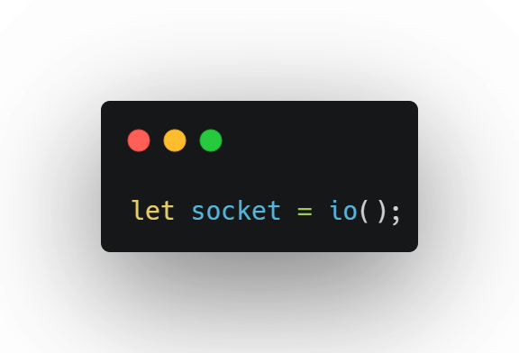
Initialize in our script

Slide 38
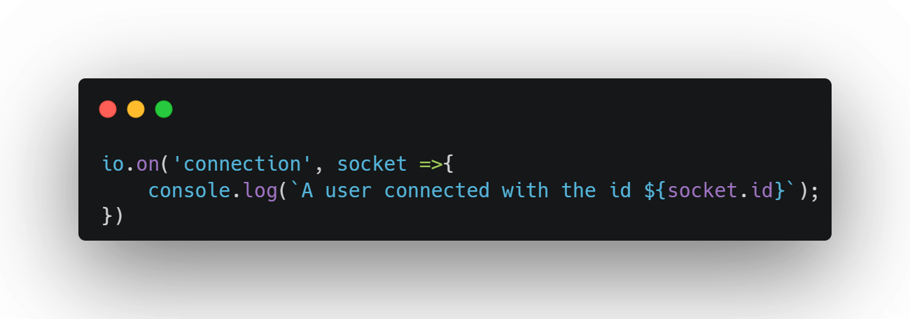
Add this to our server

Slide 39
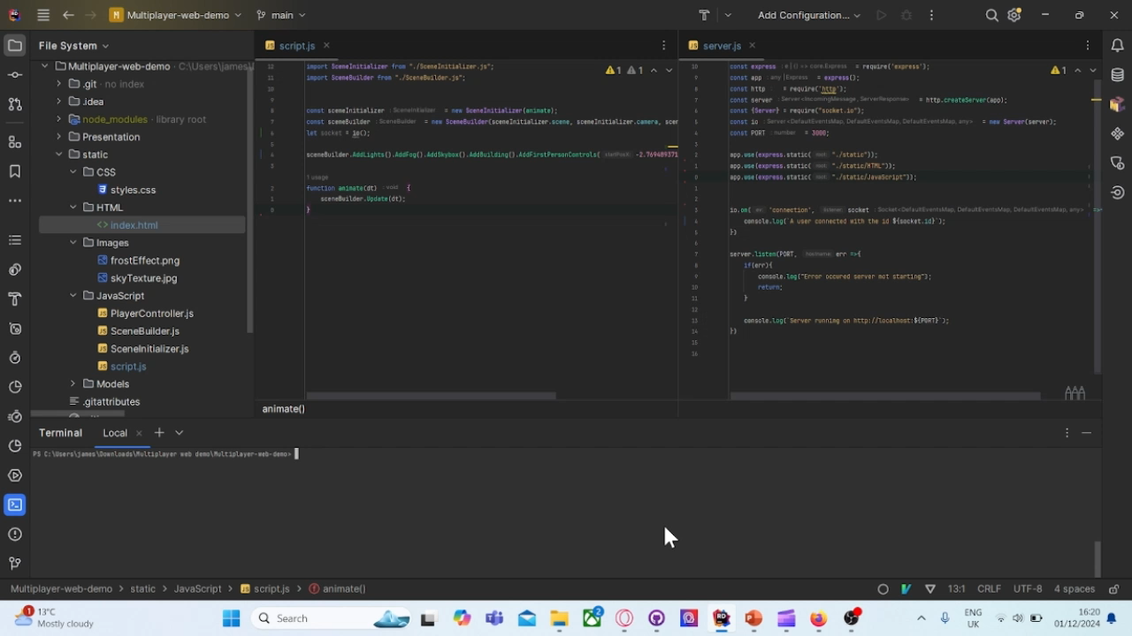
Test

Slide 40
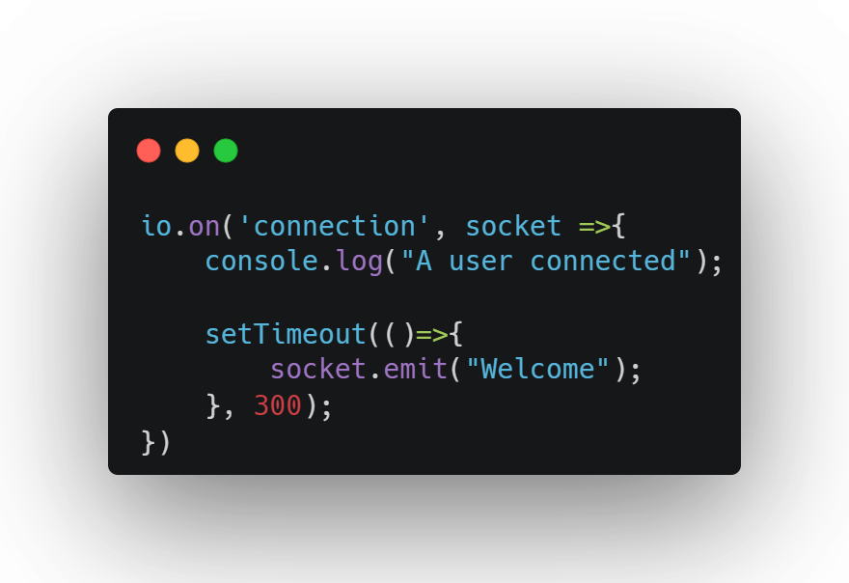
The server can send messages to the client if it wants

Slide 41
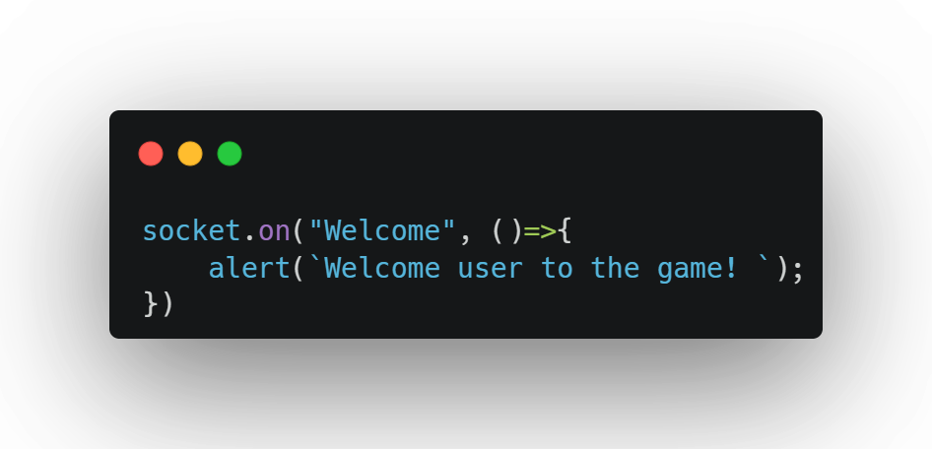
And we can create event handlers to react to these messages

Slide 42
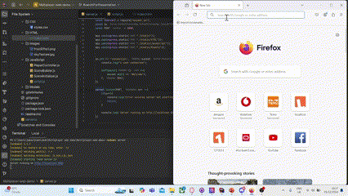
Test

Slide 43
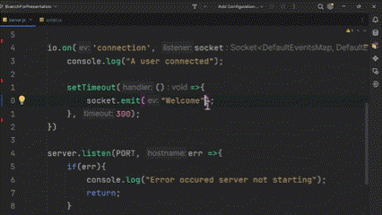
We can send custom data too if we want

Slide 44
So what custom data can we send?
Pretty much anything!! As long as it can be serialized to JSON!
This includes all of our primitive types:
Strings, numbers, Booleans and Null
We can also send objects and arrays (as long as the contents are serializable, don’t worry in my experience they always are)

Slide 45
Question
What is some data that might be useful to send to the server or synchronise between clients?

Slide 46
Answer
Position
Rotation (in y axis)
Ammo count
Health
Messages if game has an in-built chat messaging system
And probably more…
Notes:
Reason rotation is restricted to y axis is when the player looks up we don’t want the capsule to rotate too because that would look weird, would look like the capsule is floating.
So why not send the whole rotation and just ignore parts of it. We should avoid sending large amounts of data sending wasted data as this will increase latency.

Slide 47
In this demonstration we will only be sharing positional data for simplicity's sake

Slide 48
What messages will need to be sent?
To Server from Client
A message to get the position of another player (to spawn them in the correct place)
A message to notify the server when the client moves around
To Client from Server
A message to welcome the user when they connect
A message to notify the other clients when a new client has connected
A message to notify a newly connected client of the already connected clients
A message to notify other clients when a client has disconnected
A message to notify other clients when a client moves around (synch movement)

Slide 49
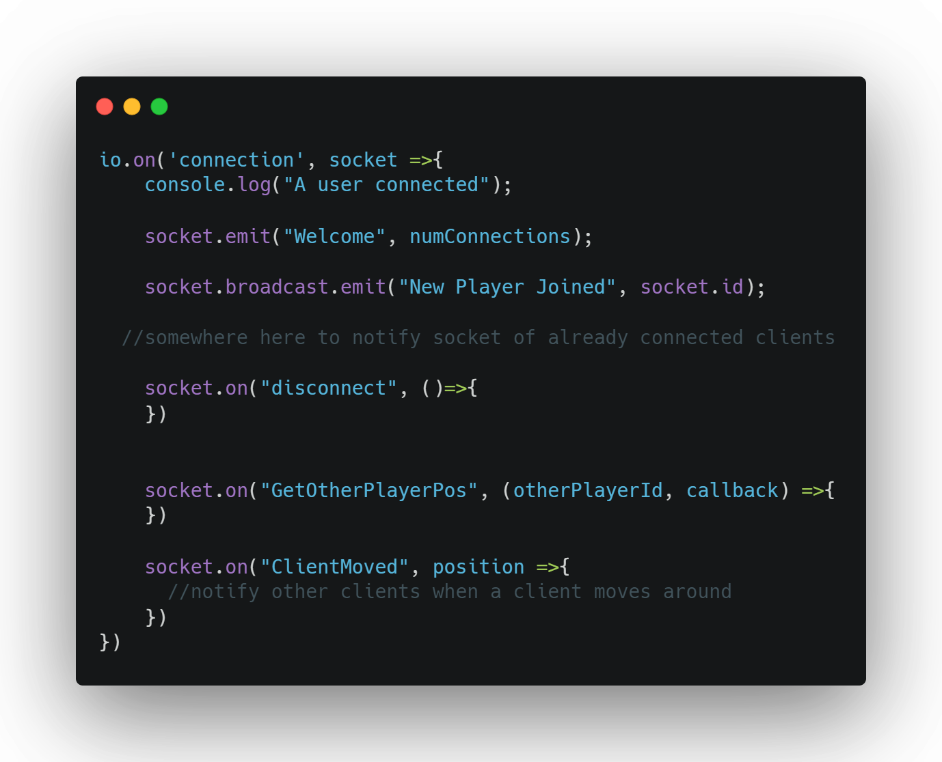
Skeleton Code for Server networking
Notes:
So you can see the two messages sent to the client
And you can see a bunch of messages received from the client

Slide 50
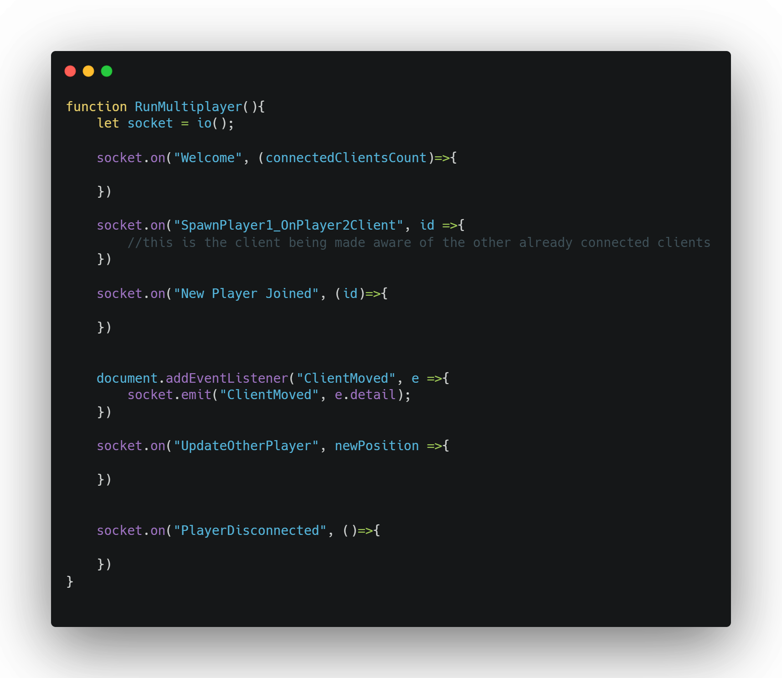
Skeleton code client

Slide 51
Steps to now get multiplayer logic working
Spawn player/client 1 and 2 in different positions (will have to keep track of number of clients)
1
Spawn a representation of client 2, client side, on client 1’s screen and vice versa
2
Network the movement of both clients
3
Gracefully handle players quitting
4

Slide 52
Spawn player/client 1 and 2 in different positions (will have to keep track of number of clients)
Pseudocode
Have the server keep track of the number of clients connected
When you send the welcome message also send the number of clients connected
When the client receives the welcome message they can do a simple if else statement to check if they are the first client or not and spawn themselves in the appropriate pre set position

Slide 53
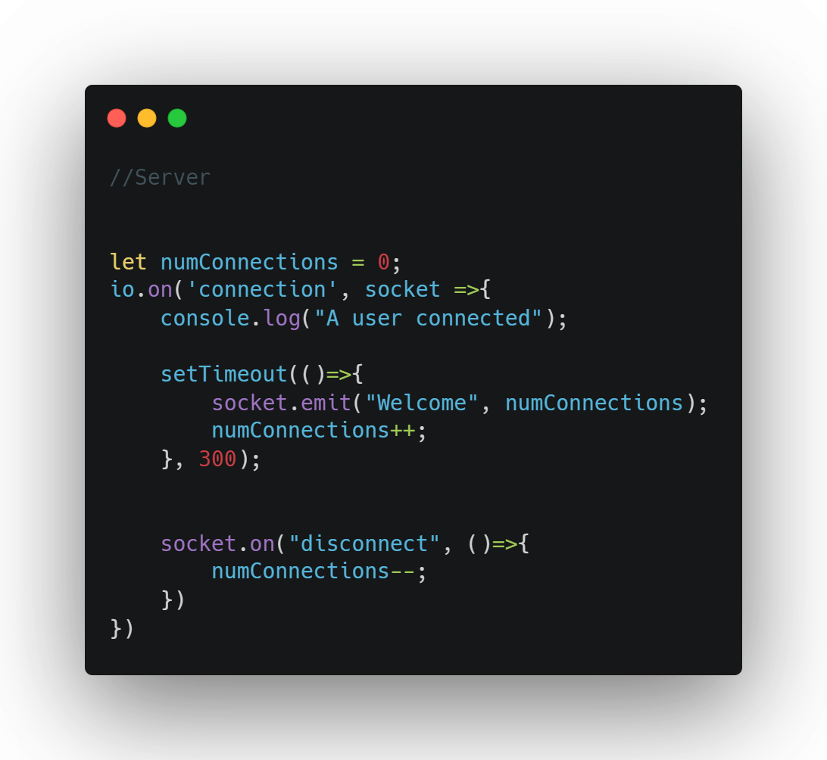
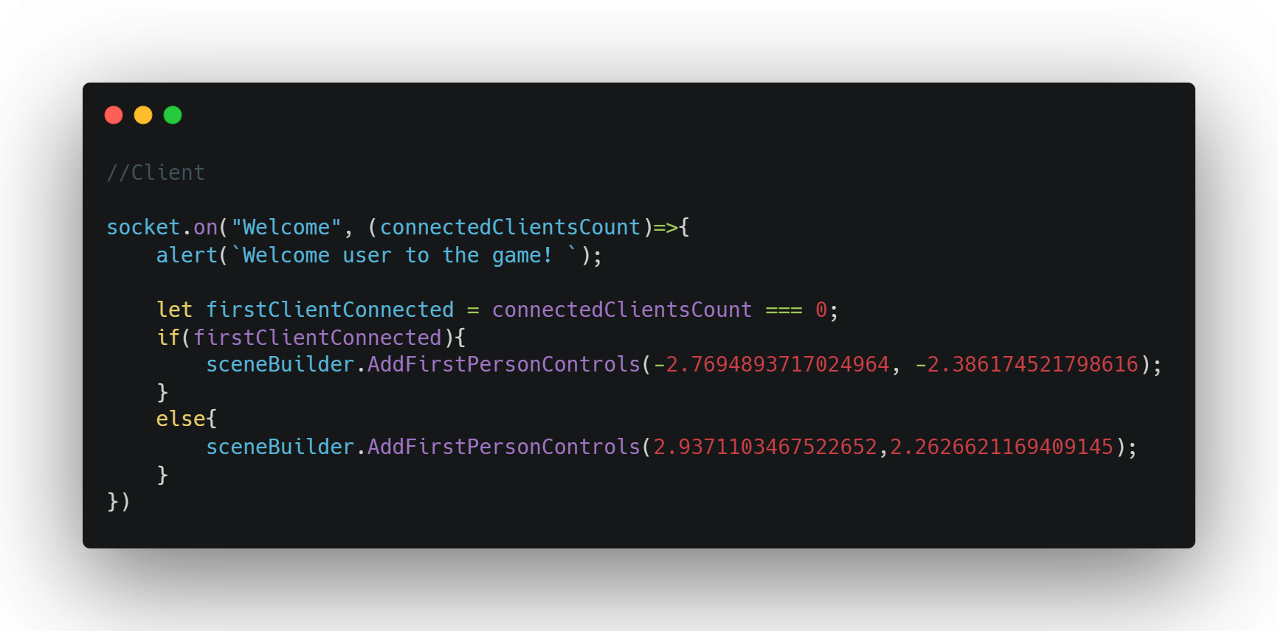

Slide 54
Spawn a representation of client 2, client side, on client 1’s screen and vice versa
Pseudocode Server
The server keeps track of each player's position starting at some default value for player1 and some (different) default value for player 2
When a socket joins if they are not the first player send the SpawnPlayer1_OnPlayer2Client message to spawn so player 2 can see player 1
Send a message to all currently connected clients that a new player has joined
When get player pos message is received, get the position of a player using the id and call the callback function passing in this position

Slide 55
Spawn a representation of client 2, client side, on client 1’s screen and vice versa
Pseudocode Client
Create a InitOtherPlayerPos function which spawns a representation of the other player into the scene at a location
Call the InitOtherPlayerPos function as a reaction to a new player joining or as a reaction to SpawnPlayer1_OnPlayer2Client.
Special case: if reacting to the latter message before you spawn the player representation you must get the position of the other player from the server using the “GetOtherPlayerPos” message

Slide 56
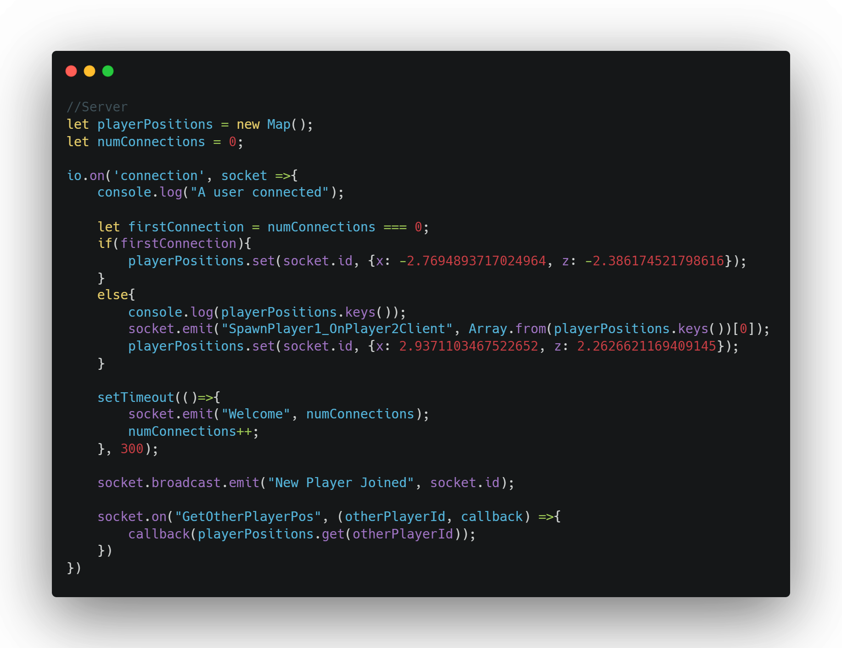
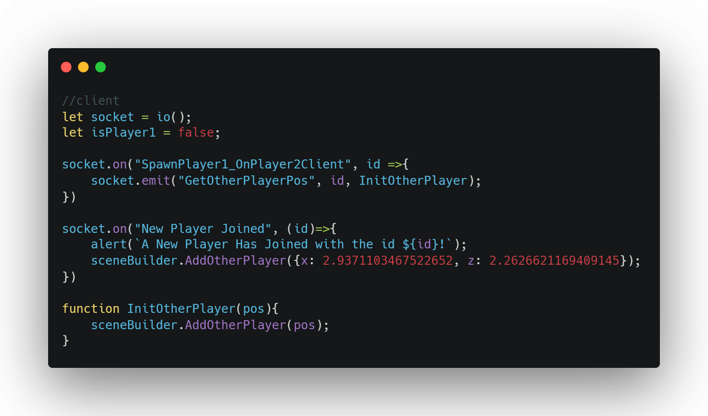

Slide 57
Network the movement of both clients
Pseudocode Client
Adjust the player controller to dispatch an event when the player moves
When this event is fired send a client moved message to the server with the new player position
When the update other player message is received update the position of the other player representation using the position supplied by the message

Slide 58
Network the movement of both clients
Pseudocode Server
When the client moved message is received
Update the stored client positions variable
Send a update other player message to all clients except the sender

Slide 59
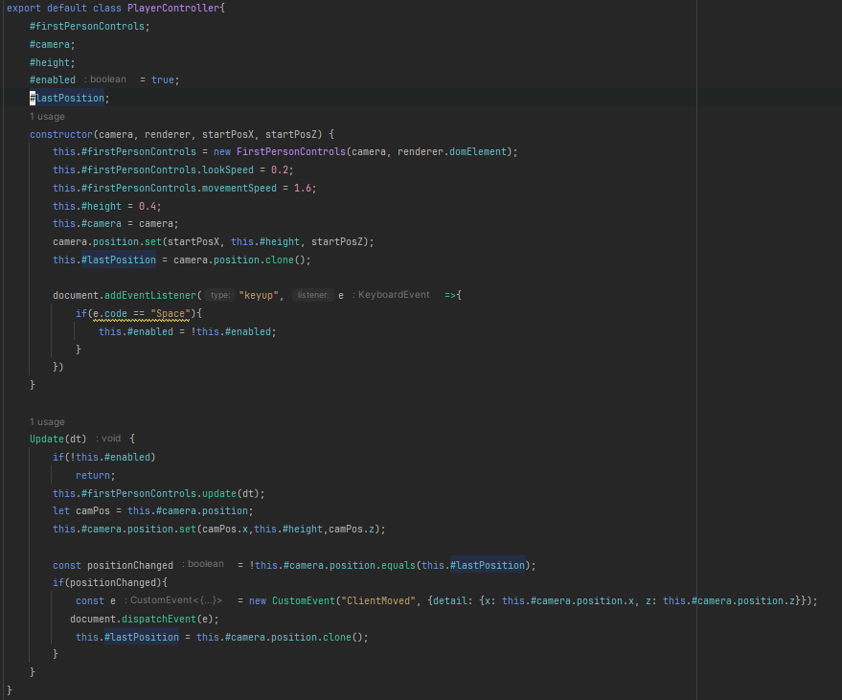
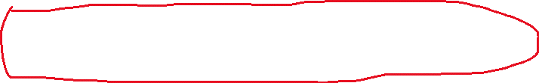


Slide 60
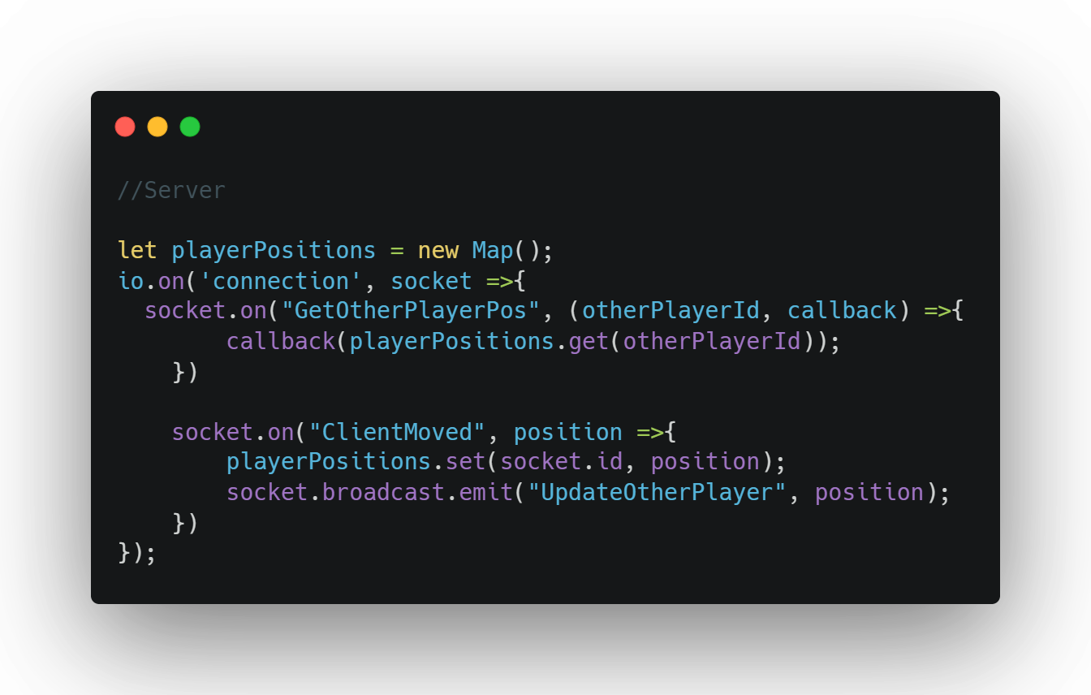
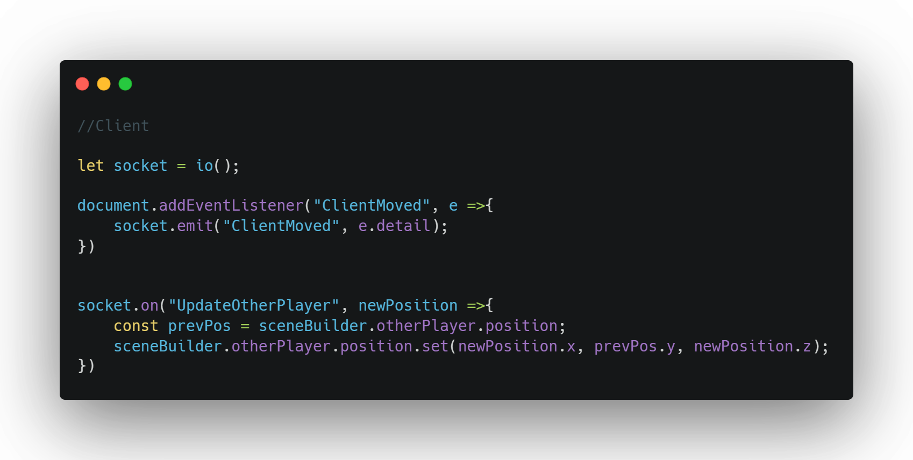

Slide 61
Gracefully handle players quitting
Pseudocode
Server
Decrement the variable keeping track of the number of connected clients
Delete and Stop keeping track of the player who's quit position
Broadcast a user disconnected message to the other clients
Client
Remove the other player representation from the scene
Set the reference to the player representation to null

Slide 62
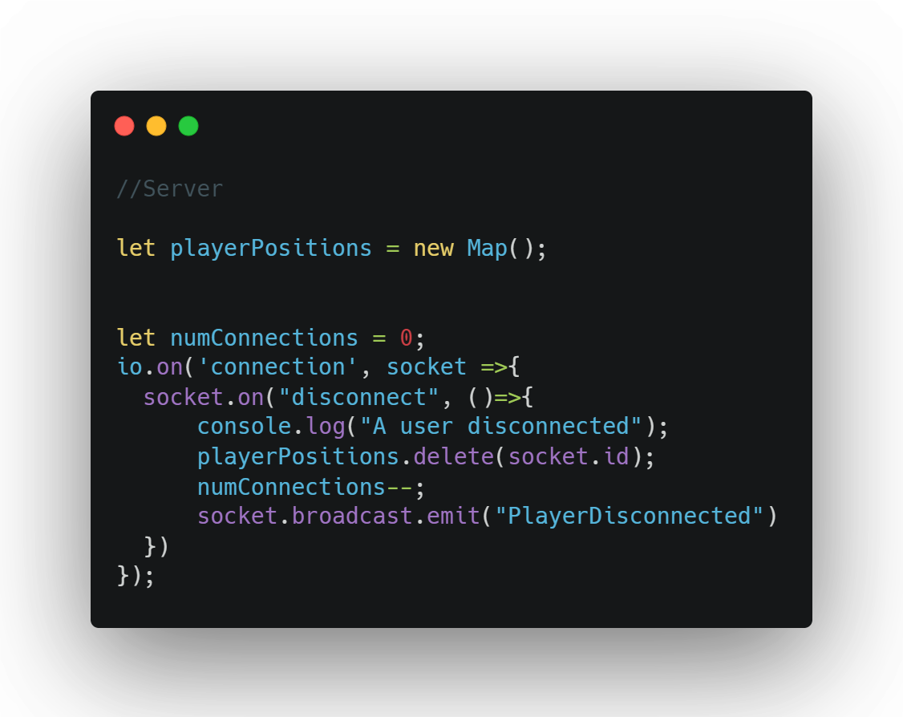
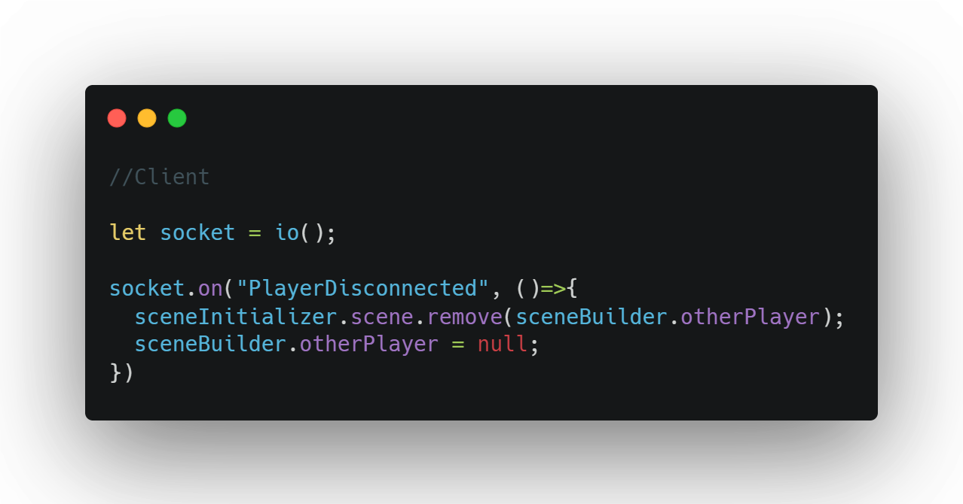

Slide 63
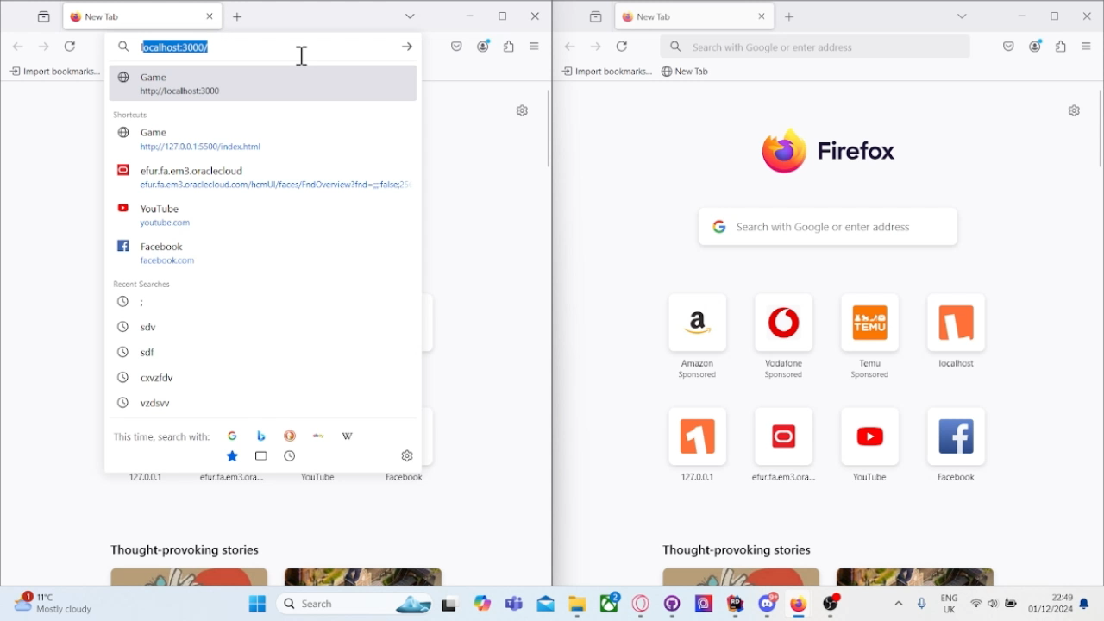
Result

Slide 64
Now we can make it look a little better by adding a title, frost screen border, removing one of the alerts, placing the camera in a nice location to start, and a button that when you press starts the networking stuff
This is done by placing the player spawning code and part of the networking logic in a function and having that function run as a result of the button being pressed

Slide 65
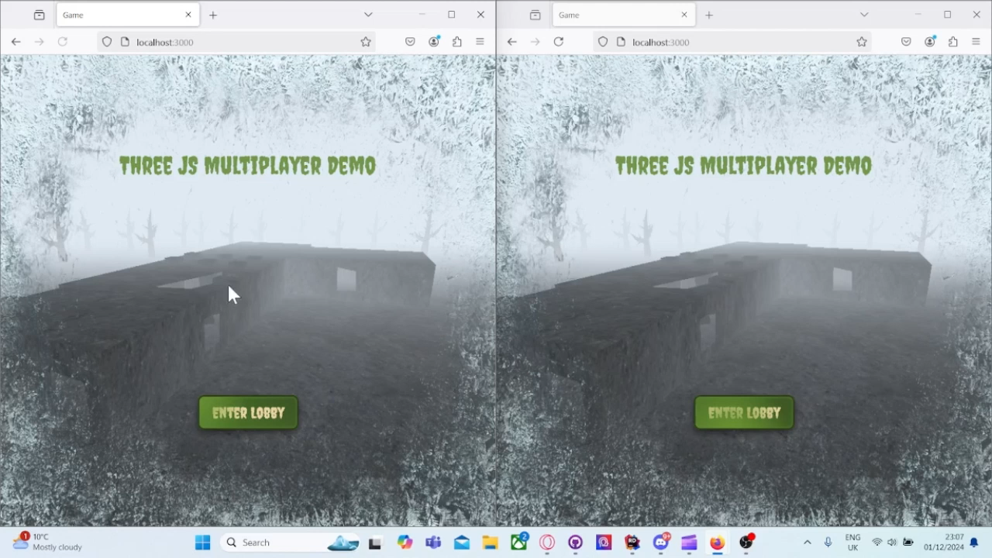

Slide 66
Game Link
Thank you to anyone that has stuck around this far!
The project is live for you to test out please feel free to test it out!
However, as it is just a demo of the, it is not designed for more than 2 players connected at once so things may look a little wonky if someone else is playing.
https://threejsmultiplayerdemonstration.onrender.com

Slide 67








Thank you for watching
Any questions?
JamesB0010
James-Richard-Bland
James Bland
AverageAltoDriver

Slide 68

In case anyone was curious
The map I recreated was Nacht der untoten from the cod zombies series 😉

